Slide 1
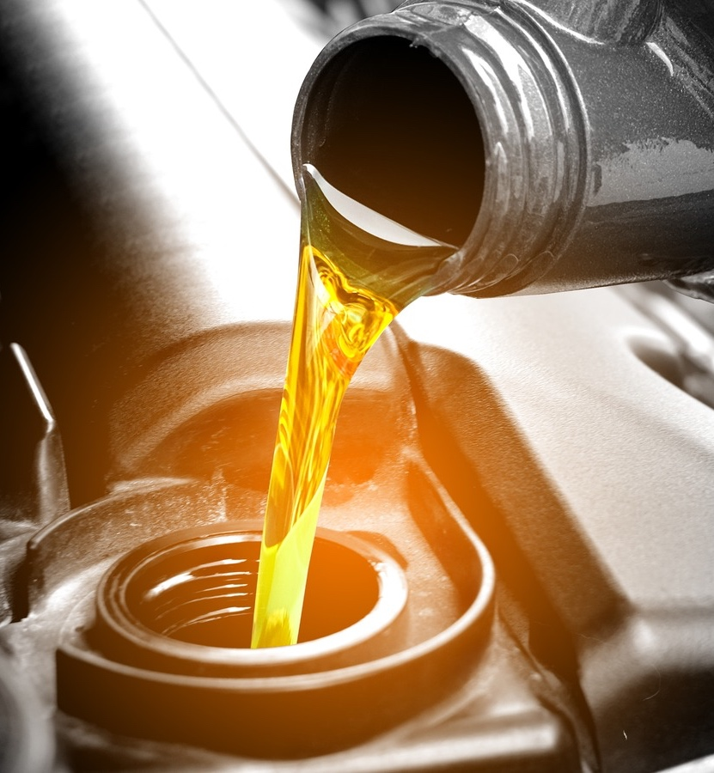
ACC Code of Practice:
Supporting Engine Oil Innovation for 30+ Years

Slide 2
Contents
Introduction of American Chemistry Council and Petroleum Additives
ACC Code of Practice Overview
Engine Test Monitoring and Control
Engine Oil Development and Qualification
Documentation and Compliance
Code of Practice Benefits and Outlook

Slide 3
The American Chemistry Council (ACC) represents more than 190 companies engaged in the business of chemistry—an innovative, economic growth engine that is helping to solve the biggest challenges facing our country and the world.
Our mission is to advocate for the people, policy, and products of chemistry that make the United States the global leader in innovation and manufacturing.

Slide 4
The Petroleum Additives Panel was formed in 1990 to pursue the research and advocacy interests of developers, manufacturers and marketers of additives used to enhance the performance of automotive and industrial petroleum fuels and/or lubricants.
Product Approval Protocol Task Group (PAPTG)
Fuel Additives Task Group
(FATG)

Slide 5









Introduction: ACC PAP Members

Slide 6
Code of Practice Plays a Role in Industry

Slide 7
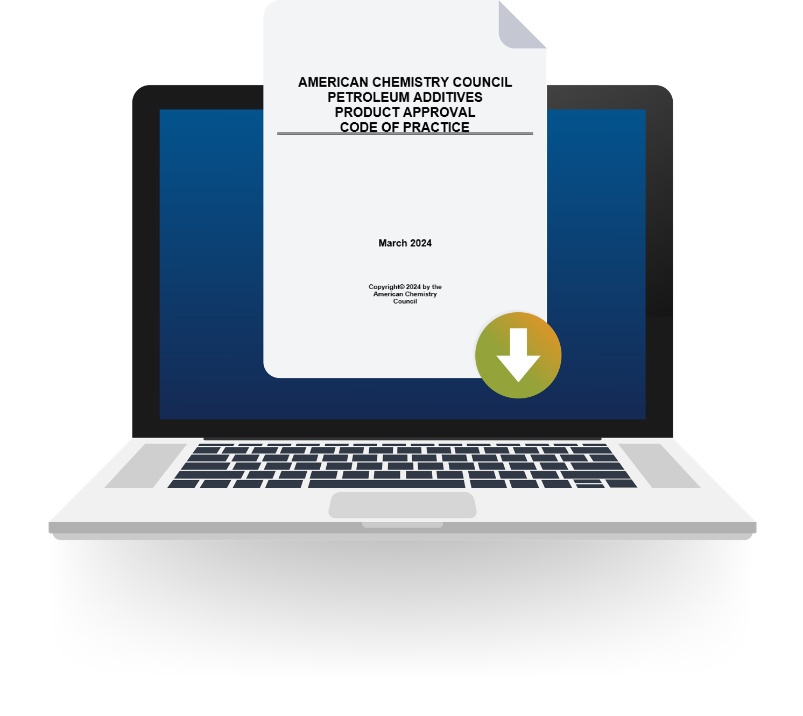
The ACC Code of Practice
Consists of
12 Core Practices
11 Appendices
5 Tabs
Which support
Engine Test Monitoring and Control
Engine Oil Development and Qualification
Documentation and Compliance

Slide 8
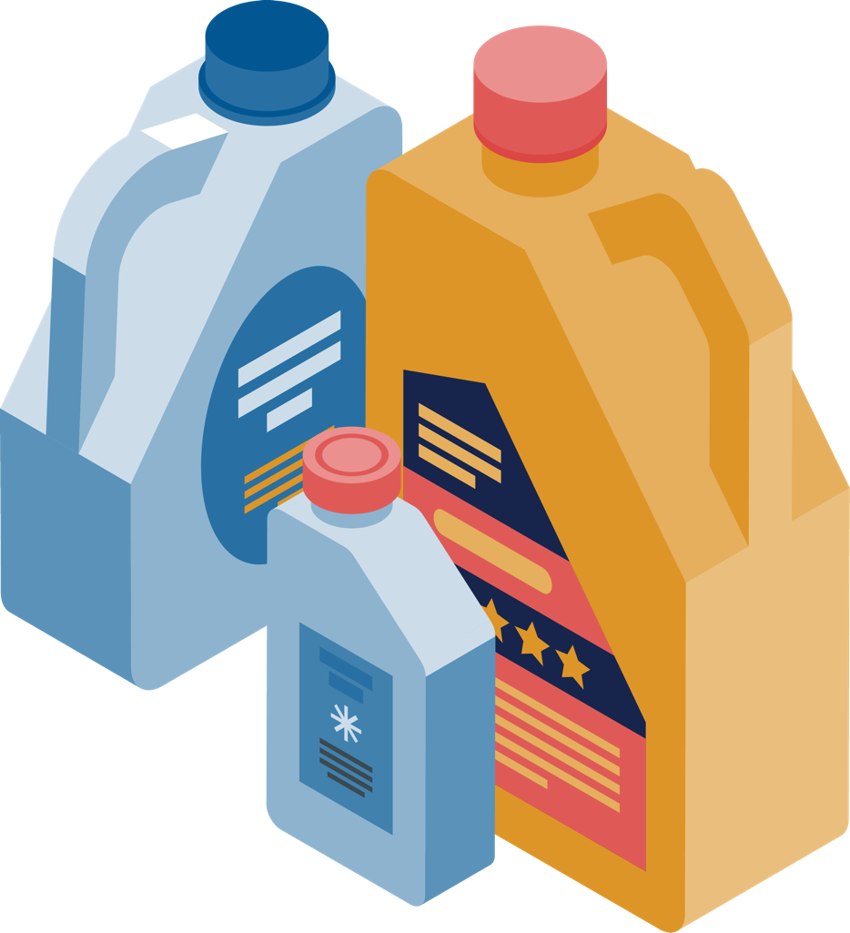
Engine Oils Licensing and Certification System (EOLCS)
~20%
Additives
~80%
Base Oil
SAE
Viscosity Grade
API Certification

Slide 9




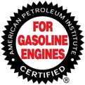
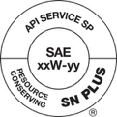

Engine Oils Licensing and Certification System (EOLCS)
OEMs
ILSAC Standards
API 1509
Code of Practice
Engine Oil Licensing and Certification System
(EOLCS)
Test Methods
Standards
Test Monitoring Center
Quality Engine Lubricants

Slide 10
Many engine oil specifications rely on the ACC Code of Practice
API engine oil category performance requirements rely primarily on ACC registered engine tests following the ACC Code of Practice
Many other global engine oil standards setting organizations include ACC registered engine tests following the ACC Code of Practice, including:
API LD Categories |  | API HD Categories
ILSAC GF-1 | API SH | API CH-4
ILSAC GF-2 | API SJ | API CI-4 and CI-4 PLUS
ILSAC GF-3 | API SL | API CJ-4
ILSAC GF-4 | API SM | API CK-4
ILSAC GF-5 | API SN and SN PLUS | API FA-4
ILSAC GF-6 | API SP
ILSAC GF-7 | API S_
Global Standards | OEM Specifications
ACEA LD Oil Sequences | GM dexos1 and dexosD
ACEA HD Oil Sequences | Ford WSS-M2C960-A1
JASO Engine Oil Standards | Stellantis MS-6395, MS-13340

Slide 11
Over 30 Year History of the Code of Practice
Petroleum Additives Panel Formation
Code of Practice Introduction
As of March 2024
API EOLCS* system records
901 Licensed Companies in
66 Countries with
27,846 Licensed Products.
1990
1992
1992
1990
1992
1996
ILSAC GF-1 & API SH introduced
ILSAC GF-2 & API SJ introduced
API CH-4 introduced
1998
2010
2010
2004
2002
2001
ILSAC GF-3 & API SL introduced
ILSAC GF-5 & API SN introduced
API CJ-4 introduced
ILSAC GF-4 & API SM introduced
API CI-4 introduced
2022
30th Anniversary
2023
New
Edition
2016
2018
2020
2025
API CK-4 and FA-4 introduced
API SN PLUS introduced
ILSAC GF-6 & API SP introduced
ILSAC GF-7 & API SQ introduced
*Information supplied by API

Slide 12
Code of Practice Emphasizes Engine Test Monitoring and Control

Slide 13
Test Acceptance into the Code of Practice
Engine tests accepted into the Code of Practice:
are based on technical and statistically valid principles and
have processes to maintain these characteristics.
Robust test development helps to
deliver high-quality, cost-effective tools which
measure the performance of a lubricant and
provide reliable, high-confidence results.
PAPTG supports the development of high-quality engine tests
  Engine Test Development Considerations
  Engine Test Development Readiness Template

Slide 14
Documentation through Test Registration
Test registration through the ACC Monitoring Agency:
ensures a record exists for engine testing of every candidate engine oil formulation and
protects the proprietary nature of the data.
ACC Monitoring Agency:
Maintains registration system and
provides expertise on Code requirements.

Slide 15
API CH-4
API CI-4
API CK-4
API FA-4
API CJ-4
API CI-4 Plus
* Source: ACC calculation using an estimated average test cost in equivalent 2023 $
ACC has registered over 13,500 HD tests since the introduction of API CH-4 in 1998.
This represents an estimated expense of more than $2 billion
in product certification testing.

Slide 16
API SP
API SL
API SN Plus
API SN
API SM
* Source: ACC calculation using an estimated average test cost in equivalent 2023 $
ACC has registered over 31,500 LD tests since the introduction of API SL in 2001. This represents an estimated expense of more than $1.5 billion
in product certification testing.

Slide 17
Code of Practice Guides Engine Oil Development and Qualification

Slide 18
Engine Oil Development and Qualification
Code of Practice’s common approach & systems for lubricant development is supported by broad industry experience and expertise.

Slide 19
Engine Oil Development and Qualification
Code of Practice guidelines allow for
Formulation optimization and controlled flexibility to improve wide availability of appropriate quality lubricants.
Minor formulation modification guidelines
General Guidelines and Guidelines for Specific Tests
Extension Program

Slide 20
Code of Practice Supports Documentation and Compliance

Slide 21
Candidate Data Package
Candidate Data Package provides assurance to customers and others regarding
  compliance with Code requirements
  targeted performance of the engine oil formulation.

Slide 22
Compliance Process - Annual Audit
  Compliance with the ACC Code of Practice is voluntary and has annual requirements.
  Letter of Intent to comply with the Code of Practice
  Self Evaluation Checklist
  3rd Party Audit by ACC Approved Auditor

Slide 23
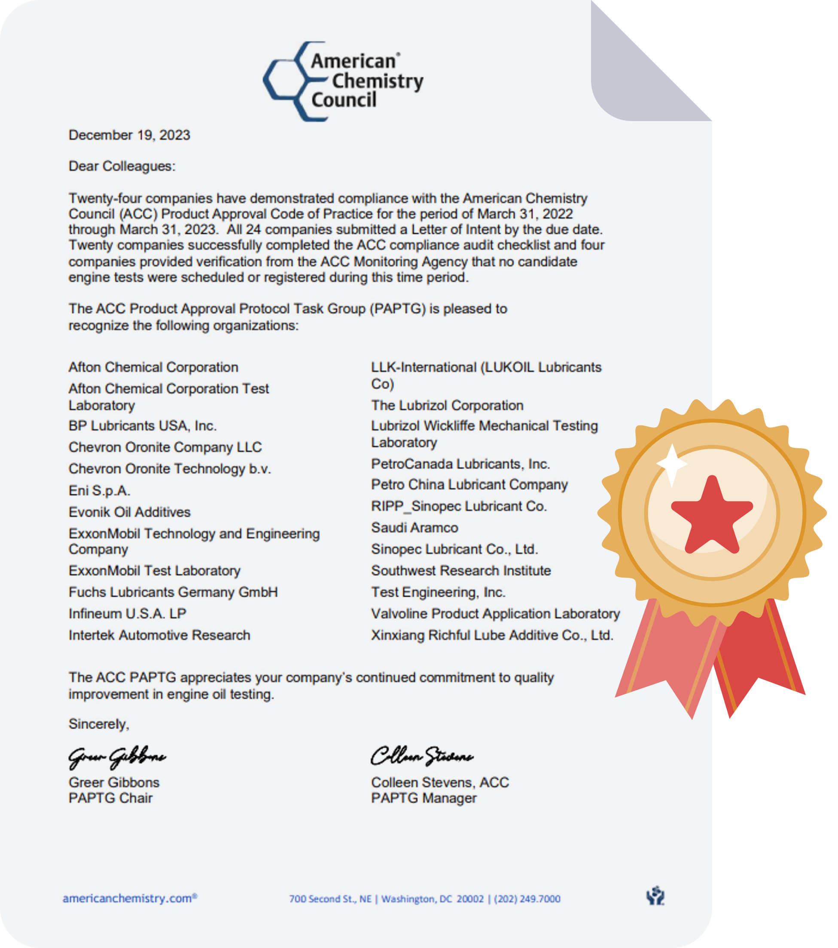
Compliance Acknowledgement
  ACC issues annual Code of Practice Compliance Letter
  for Test Sponsors and Test Laboratories.

Slide 24
Code of Practice Benefits Will Continue

Slide 25
Benefits to Stakeholders
OEMs
Code of Practice underpins the wide availability of lubricants meeting SSO performance requirements and the consistent quality of engine lubricants helps protect engines.
Industry Standard Setting Organizations
Code of Practice provides a common approach, systems, and controls with demonstrated robustness for lubricant development.
Lubricant and additive industry
Code of Practice provides the common approach, systems, and controls for timely, cost-effective engine lubricant development while allowing for flexibility for formulation optimization.
End user
Code of Practice improves confidence in lubricant performance claims and allows for the wide availability of lubricants of appropriate quality.

Slide 26

PAP Summary & Outlook
  The Code of Practice has served the industry well for over thirty (30) years and we’re looking forward to the next thirty!
  We want to engage with YOU! PAP members are technical experts and resources for the lubricant and fuel industries.
  We’re excited to
    Continue Code of Practice education.
    Explore fuel additive industry’s role during energy transitions and benefits for renewable diesel.

Slide 27
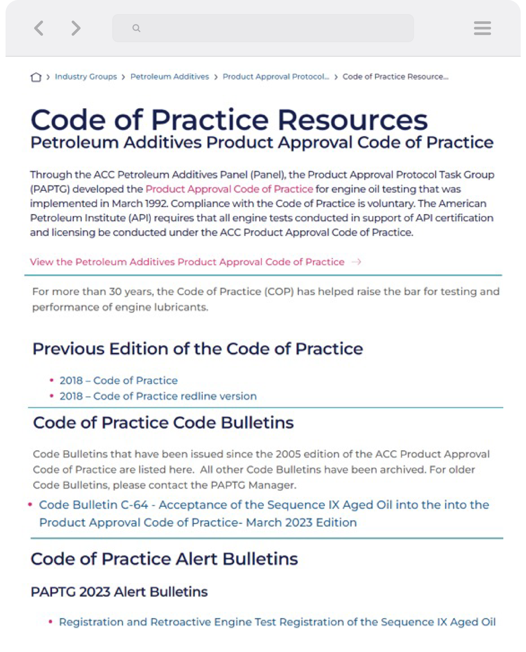
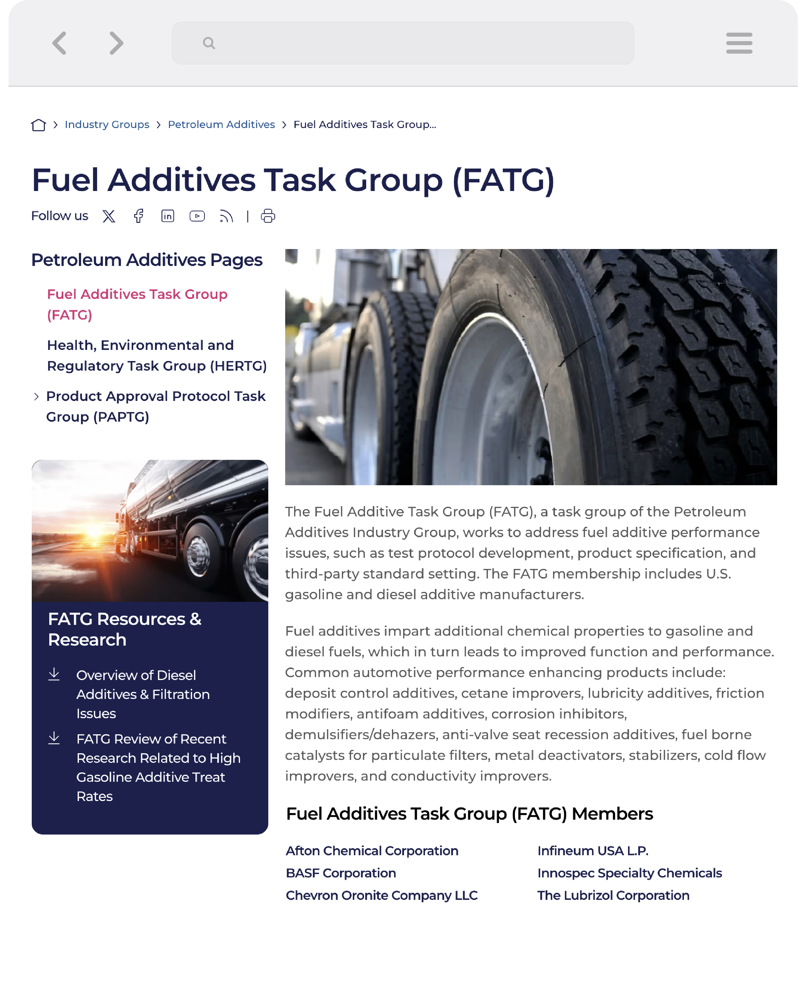
ACC Petroleum Additives Panel
Resources are Publicly Available

Slide 28
For further information or to subscribe to the Code of Practice Stakeholders email list, please contact
Colleen Stevens
American Chemistry Council
Director, Chemical Products & Technology Division
Colleen_stevens@americanchemistry.com
700 2nd Street, NE | Washington, DC| 20002
O: 202-249-6713

